Slide 1


Secure Application Development
Assessment 02
Student Name: Kapasakalis Alexandros
Bolton ID: 1000491
Marking Instructor: Mr. Fouzas
April 2024

Slide 2
Theoretical Background
In the world of Application Development, practitioners need to take into consideration, the ever growing threat of cyber attacks. Obviously the infrastructure that hosts the application needs to be secured, but a good security in depth practice begins at the first steps of the applications lifecycle.
In order to create applications, that are considered secure, developers need to incorporate practices to avoid building vulnerabilities inside the code. For example proper access control to avoid SQL injections. This practice is named Secure Application development.

Slide 3
Subject of the Assessment
The current assessment aims to create a simple application and incorporate secure methods in the code to grant access to users. In general practices to make sure that the code is secured will be used.
For this project, the user has created an application where users can login, logout and sign up to the platform. The application is based on Next.js which is a React Framework of Javascript and allows font manipulation. The code was developed on Visual Studio Code.
For the purposes of analyzing the validity of the code and scanning it for cybersecurity vulnerabilities an extension of the VS code was used named Snyk. This is an Open-Source tools that allows the developer to scan the code against known vulnerabilities using its databases. The plugin is used to present the finding while the Snyk Platform monitors the code from Github, thus offering CI/CD usage.

Slide 4

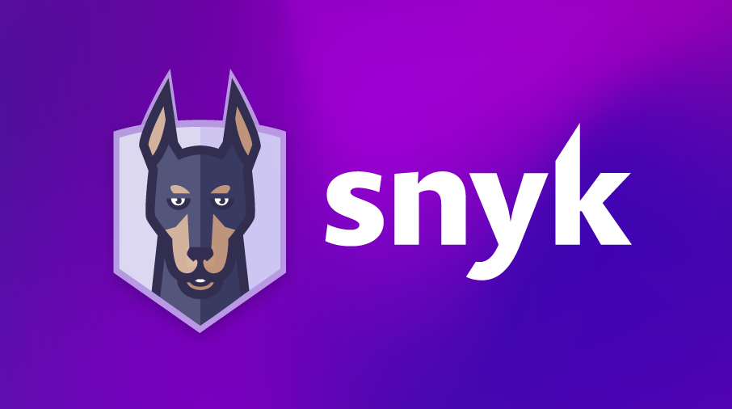

Use of Database
The application is connected through the use of URI created from Atlas provided by MongoDB. This publicly available service allows the users to host a small database that will serve the purposes of this assessment.
The application is connected with the Database and allows the users to store their credentials there. The developer has taken into account to secure the application properly. We will now be describing the methods that were used to secure the application

Slide 5
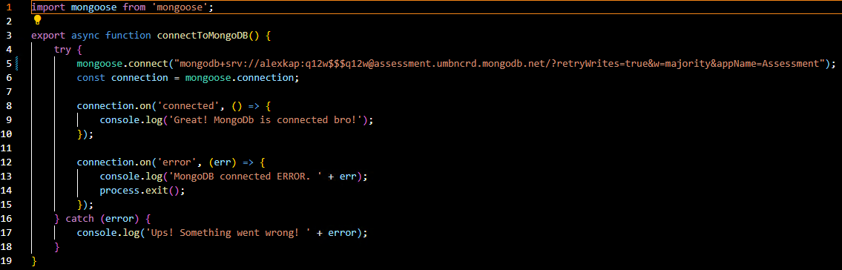
Access to the Database
The image shows how the developer has connected the application with the database. An obvious vulnerability is that the connection should not have hardcoded passwords and credentials. Snyk has marked the 5th line as vulnerable, but the vulnerability exists only for the purposes of the assessment. In a production environment the database would connect with the application through the use of a secured API.

Slide 6
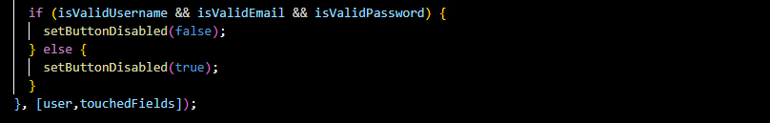
Access Control
Since the users will be signing up the developer has set up a few methods that prevent unwanted access. In other word, the developer has predetermined security standards.
An example of those standards are Password and Username standards. In the image below these configurations are displayed.
When the user is prompted to provide the credentials that will be used in the future, the inputs should adhere to the above specifications.
In the event that the standards are not met, the button for the sign up is disabled.

Slide 7
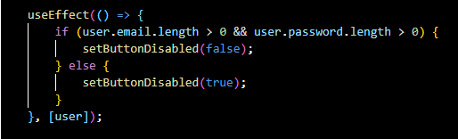
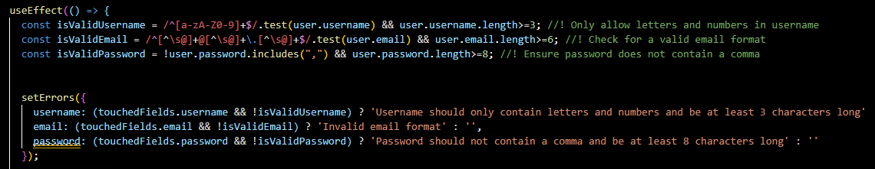
Access Control
The same happens when the users attempt to login. They need to provide username and password in order to access the application.
The format of the Username and Password has been predetermined in the sign up process, determining a proper way to check the format of the email and the strength of the password

Slide 8
Login Process
The user is prompted to insert their credentials. Again the same format is used and the buttons for login do not become available unless the inputs are in the predefined format.
The application receives the valid inputs from the users and creates a token. The token is then sent to the database through the API. The request is handled by libraries like axios.
To prevent SQL injections the format of the credentials is performed to the program and then the Token is created. Unless the user provides a valid format the Token is not generated. The program checks if the email exists in the database and then fetches the password for the validation.

Slide 9
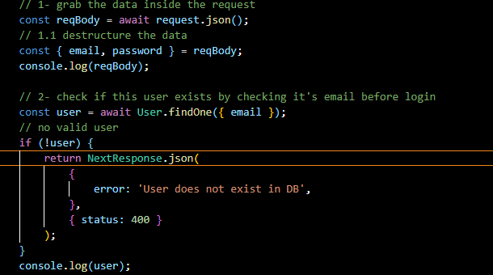
Validation
The user will be prompted with a 400 error if his email is not present in the database.

Slide 10
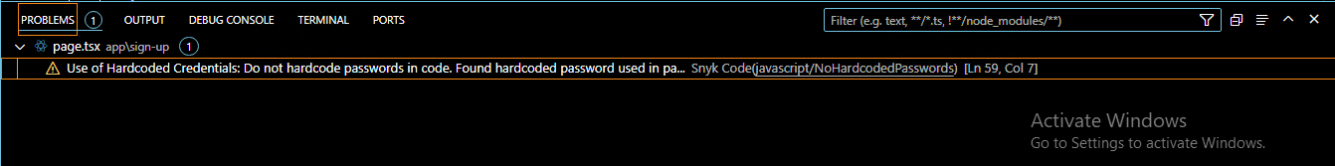
Conclusion
By engaging in Secure Methods for the application, the developer was able to create a sound code without unwanted vulnerabilities.
The result of those methodologies is the scanning from the integration of Snyk as a CI/CD to provide a mostly clean security report:

